Slide 1



Slide 2

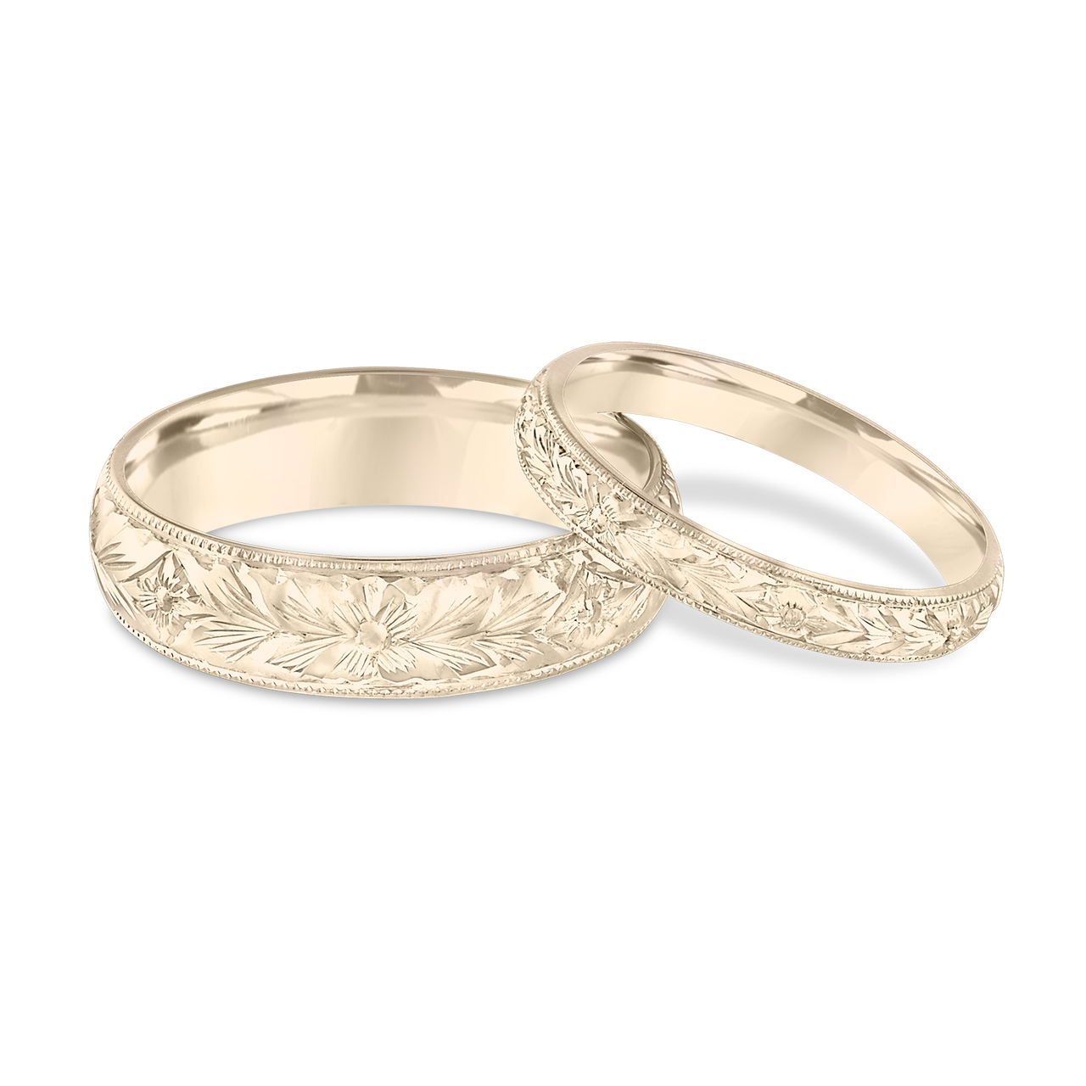
Light Lesson 18 Walking in the Light: Marriage Building Your Dream Home (Part I)

Slide 3

Introduction
Ephesians 5:8 teaches us, who in the past were in darkness, to walk as children of light.
We want to walk as children of light in our marriages, knowing God will bless us in our obedience.
A couple had begun work on what they had called their “dream house”—a beautiful, roomy, modern house in the country. Work had already begun. The land was cleared, the foundations laid, and the basement constructed. But then suddenly the building stopped. The couple had started having marital problems they could not resolve. Soon after, they got a divorce, and the dream house they had planned together was never completed. Their partially built house was a constant reminder of their failed marriage.
Some couples put far more thought into building their dream “house” than they do in building the “dream home” that will live in the house
“How to Build Your Dream Home.”
If we want to build a dream home, we must do the same things we would do in building a dream house.

Slide 4

Consult the Architect
Most people would never think of building a house without first consulting with an architect either directly or indirectly.
Some cities will not allow you to build a house without a plan approved by an architect.
The issue is simple: Everyone needs to know the design of their house is structurally sound, that it will stand up over time, and withstand the storms that might come against it.
Yet, many people start a home without much, if any, thought to the architect’s plan for their home.
Both couples and parents do not always consider the expertise of the architect when they think about what their home should be like.

Slide 5
Consult the Architect
The architect of the home is God.
The family is His institution.
His plan for the composition of the home is revealed in a straightforward manner in Genesis 1-2.
But if it is important to recognize that God is the architect of the home, it is equally important to understand the purposes the Architect had in mind when creating the home.

Slide 6

Consult the Architect
God’s architectural plan for the home had multiple purposes.
His plan would provide a means of filling the earth He had made with inhabitants (Gen 1:28).
It would provide companionship and mutual fulfillment of both the husband’s and wife’s needs (Gen 2:18).
It would provide a safe environment to nurture children (Eph 6:4; Gen 18:19).
It would constitute an important component for a stable society and civilization (Prov 14:34).
It would be a place to teach the principles of love and service (Gal 5:13).
It would be a type of Christ and His church (Eph 5:32).

Slide 7

Consult the Architect
God envisions a happy home to those who follow His plan.
Sometimes people use their pursuit of happiness as justification for discarding God’s plan.
God did not create the home to make people miserable, but rather to enhance their personal well-being.
He wants your home to be beautiful.
And the Scriptures often describe the joys of marriage and family (Prov 5:18; 18:22; Eccl 9:9; Deut 24:5; Prov 23:24).

Slide 8

Consult the Architect
In contrast, failure to follow God’s plan can bring disaster.
Probably everyone has heard of the collapse of a building because the builder didn’t respect the designs suggested by the architect.
Similarly, people try to circumvent the design of the Creator when building their godly homes:
Some will treat marriage as a merely human contract to be discarded at will and without consequence.
Some will seek to make a home composed of people of the same sex.
Some will seek to experience sexual fulfillment without the commitment and bonds of matrimony.

Slide 9


Consult the Architect
These human substitutions not only militate against the purpose of the Architect; they also punish the misguided builders!
Today we are paying an expensive price in personal and social pain for dysfunctional people raised in dysfunctional homes.
Divorce breaks down the social structure of society.
Lack of proper nurture manifests itself in rebellion against authority and personal disrespect that leads to immoral living.
Remember this verse: “Unless the Lord builds the house, They labor in vain who build it; Unless the Lord guards the city, The watchman keeps awake in vain” (Psa 127:1).

Slide 10

Lay a solid Foundation
In July 2017, several houses in Land O’ Lakes, Florida suffered collapse due to an expanding sinkhole underneath them. It happens periodically in Florida as well as other parts of the country. Thankfully in those cases no one was injured or killed by the collapse, but several years ago a Florida man lost his life in a similar incident which occurred at night while he was in bed. The earth simply swallowed up the man and his surroundings. In the aftermath of these experiences, other residents of the area naturally were quite on edge for quite a while since they too wondered if such a thing could happen to them also. It is understandable they would be anxious about the possibility that their homes were built on inadequate foundations also.

Slide 11
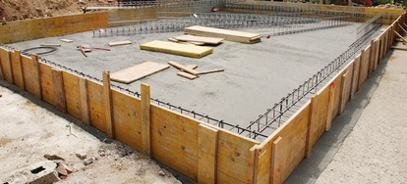
Lay a solid Foundation
If building on a solid foundation is essential in building a house, how much more when seeking to build our dream homes.
Jesus used that very analogy of building on rock or building on sand to stress the importance and wisdom of listening to His sayings rather than rejecting them (Matt 7:24-27).
Likewise, our homes must be built on a solid footing.
The Architect has given us the principles that will enable our marriages and homes to succeed.

Slide 12
Faith in God
Some would not think of faith in God as foundational to a happy home, but we cannot underestimate the value of this principle for more than one reason.
First, faith provides the motivation to listen to the Architect’s directions. And we have every reason to believe those directions are given with divine wisdom and care for us (Deut 6:24).
Second, faith acknowledges the accountability that keeps us honest in our relationships.
We know we must ultimately answer to the Creator for our conduct (2 Cor 5:10).

Slide 13
Faith in God
We cannot read the NT without seeing that our conduct in the home, as in all relationships, is tied to our relationship to God and His Son Jesus Christ (Titus 2:4-5; 1 Pet 3:7; 1 Tim 5:8).
Someone may question, “Are you saying unbelievers and atheists can’t have a happy home?”
No, but even in their case, if they succeed, it will be because they have embraced the principles God has given, even if they deny their origin.
They will lack the essential motivations to listen to God and do what is right if they become unhappy with the relationship.

Slide 14
Faith in God
In contrast, when two people, united in faith, become marriage partners and parents for life, the quality of their relationship will change.
It has to work better because everything Jesus touched became better. If a word from the Lord could make the finest wine in Cana of Galilee, then a word from the Lord can make the finest homes anywhere.
If your faith in God is waning, you are not only risking your soul; you are risking your home.
There is a crack in the foundation that needs immediate attention before disaster strikes.

Slide 15

Commitment
God describes commitment with the simple formula “leave and cleave” (Gen 2:24).
Both words are important.
The word “leave” does not suggest children no longer respect or honor their parents, but it does suggest they are forming a new unit that is independent of their parents.
One judge, when asked why there were so many divorces in his courtroom, responded with a single word--“in-laws.”
Parents should not interfere with their children’s relationships.
Children need to cut the umbilical cord and take responsibility for the success of their marriages without thinking, “I can always go back home to momma and daddy.”
The word “cleave” suggests you are all in for all time. You are not just bodily staying in the house; you are endeavoring to make things work.
Notes:
Faith in God and the commitment to do right provides the incentive to work things out.
This is what I think is especially objectionable about the concepts of people living together without marriage or what is called “trial marriage.” Not only does it defy the will of the Creator who designed marriage to be a committed relationship. it also casts doubt upon the integrity of the commitment. It is like saying, “I am here to stay…while you glance over and see the door is clearly cracked, ensuring the possibility that you can walk out at will.” If you reserve the right to look elsewhere rather than seek to please your mate, there is a crack in the foundation that risks total collapse.

Slide 16

Trust
All of us need to work to build trust.
One way we build trust is doing what we say we will do, being where we say we will be, and being there when we say they will be there
The worthy woman received a high compliment in Proverbs 31: “The heart of her husband trusts in her, And he will have no lack of gain” (Prov 31:11).
Maybe we could learn something from the mistake of the strong man Samson. He was not very wise in the ways of love. He married a Philistine woman, and she was not trustworthy with his secrets. At their marriage feast, Samson proposed a riddle for the entertainment of the guests; however, his wife later persuaded him to reveal his secrets to her. Then she disloyally shared them with her family. The marriage was defeated before it started because of distrust.
A husband and wife need to build trust by faithfulness, by consistency, and by avoiding relationships that appear to compete with their spouse.
Notes:
Husbands and wives cannot be with one another 24/7. Each must believe that the other will be loyal and true when the other is not around. That trust cannot be built by one mate peppering the other with questions about everything they did that day. Instead, it is developed by knowing a person’s character and affirming their loyalty. All of us need to work to build trust.
One way we build trust is doing what we say we will do, being where we say we will be, and being there when we say they will be there. Over time, not keeping our word will erode trust and replace it with cynicism. People will not believe you when you promise anything when they have seen how many times you back out of your promises, leave them stranded, and/or change your plans constantly at someone else’s expense.
The worthy woman received a high compliment in Proverbs 31: “The heart of her husband trusts in her, And he will have no lack of gain” (Prov 31:11).
Maybe we could learn something from the mistake of the strong man Samson. He was not very wise in the ways of love. He married a Philistine woman, and she was not trustworthy with his secrets. At their marriage feast, Samson proposed a riddle for the entertainment of the guests; however, his wife later persuaded him to reveal his secrets to her. Then she disloyally shared them with her family. The marriage was defeated before it started because of distrust.
A husband and wife need to build trust by faithfulness, by consistency, and by avoiding relationships that appear to compete with their spouse.

Slide 17

Respect
If trust is an essential component of a solid foundation, then so also is respect.
Respect combines elements of esteem and consideration.
Both husbands and wives are urged in Scripture to give honor to one another (1 Pet 3:7; Eph 5:33).
Likewise, respect must also move beyond admiration to consideration.
Maybe we could say it is taking that sense of admiration or appreciation and putting it into concrete expressions of kindness and service that meet the needs of their mate.
Paul captures the idea in 1 Corinthians 7. It was a “given” with him that any married person would be focused on pleasing the one they had married (1 Cor 7:33-34).
We show respect by validation, by allowing a person to express how he feels without judgment or denial.
Notes:
If trust is an essential component of a solid foundation, then so also is respect. Respect is a hard word to define. It combines elements of esteem and consideration.
There is something intrinsic to human nature that seeks to be admired, held in high regard, or appreciated and valued for who they are and/or what they do. Both husbands and wives are urged in Scripture to give honor to one another (1 Pet 3:7; Eph 5:33).
Likewise, respect must also move beyond admiration to consideration. Maybe we could say it is taking that sense of admiration or appreciation and putting it into concrete expressions of kindness and service that meet the needs of their mate. Paul captures the idea in 1 Corinthians 7. It was a “given” with him that any married person would be focused on pleasing the one they had married (1 Cor 7:33-34). We show respect by validation, by allowing a person to express how he feels without judgment or denial.

Slide 18


Love
Of course, one of the most fundamental principles of the home is love.
It is the cement that binds all godly qualities into a unified whole (Col 3:14).
Love has special applications in marriage since it is a relationship like no other (Titus 2:4-5; Eph 5:25).
Every culture recognizes that love in marriage has multiple dimensions
Husbands and wives are lovers.
Husbands and wives are friends.
Husbands and wives are devoted servants.
Each of these qualities will make a foundation for your dream home that is strong and permanent.
A collapsing house may be costly and painful, but a collapsing home is far more serious. Thankfully the cracks in the foundation can be repaired and put on a more solid footing. But we each must have the humility to acknowledge where we are causing cracks in the foundation.
Notes:
Of course, one of the most fundamental principles of the home is love. It is the cement that binds all godly qualities into a unified whole (Col 3:14). Love has special applications in marriage since it is a relationship like no other (Titus 2:4-5; Eph 5:25).
Every culture recognizes that love in marriage has multiple dimensions. In the Greek culture, it was born out by the differing words for love in a relationship. The Scriptures likewise suggest that love in marriage has three dimensions. We’ll introduce them now and probably speak more about them in later lessons.
Husbands and wives are lovers. Husbands and wives are friends. Husbands and wives are devoted servants. Each of these qualities will make a foundation for your dream home that is strong and permanent.
A collapsing house may be costly and painful, but a collapsing home is far more serious. Thankfully the cracks in the foundation can be repaired and put on a more solid footing. But we each must have the humility to acknowledge where we are causing cracks in the foundation.

Slide 19
Follow the Architect’s blueprint for the husband of her dreams
The construction of a dream home begins with the joining of man and woman in marriage; however, it is important that each understand the Architect’s plan for their role in the family. So, let’s start with a husband built according to the Architect’s plan. Hopefully, such a man will be the husband of her dreams as well. God envisions:
A husband who will lead
Notes:
A husband who will lead: Of all the images by which to teach men their role, God chose the word “head.” The image itself is helpful for many reasons. It reminds us the home is a living organism that must be directed and cared for like a body. It reminds us the head is the seat of wise and considerate planning and direction. It reminds us the head knows well the needs of the body and responds to them.
It is important to note that God did not call the husband the “tyrant” of his home. The tyrant’s rule is selfish and abusive of those under his control; the head’s rule is selfless and caring of those under his leadership.
The husband finds his analog for headship in the example of Christ; again and again, Paul appeals to Christ’s headship as a model for the dream husband (Eph 5:23). The image of man as head of his wife and home suggests that his role is one of leadership.
Feminist interpreters have sought to dismiss the concept of leadership implied in headship by insisting that it means merely “source,” not “rule.” However, the biblical model clearly suggests the idea of considerate ruling which is accountable to the Creator (1 Tim 3:4-5).
The Greek word for “manages” in this text conveys the idea of being at the front, being the head of, directing, and stepping up to show care or concern and to give help. It is implied in the complementary command to wives to “submit” or “be subject to” her husband.
The dream husband exercises headship by:
Setting a vision or goals for the family.
Monitoring the activities of the home so they meet the divinely-planned purposes.
Exemplifying the character and activities he seeks in others.

Slide 20
Follow the Architect’s blueprint for the husband of her dreams
The construction of a dream home begins with the joining of man and woman in marriage; however, it is important that each understand the Architect’s plan for their role in the family. So, let’s start with a husband built according to the Architect’s plan. Hopefully, such a man will be the husband of her dreams as well. God envisions:
A husband who will lead
A husband who will love
Notes:
A husband who will love: A husband’s leadership must be done in love! Paul once again appeals to the headship of Jesus to direct the dream husband (Eph 5:25-30). Paul appeals to the creation account to guide the dream husband’s thinking about his wife and family. Recalling the method by which woman was first formed—from the man’s own body, he converts the image into action (Eph 5:28-29).
To hate one’s flesh is to fail to nourish and cherish it; to love it is to:
Nourish—that is, to meet the needs of his wife (physically, sexually, emotionally, and spiritually).
Cherish—The Greek word derives from the image of the mother hen spreading her wings over her young to keep them warm. It is used of a mother’s tender care for her children in 1 Thessalonians 2:7.
Peter applies this principle this way: “You husbands likewise, live with your wives in an understanding way, as with a weaker vessel, since she is a woman; and grant her honor as a fellow heir of the grace of life, so that your prayers may not be hindered” (1 Pet 3:7).

Slide 21
Follow the Architect’s blueprint for the husband of her dreams
The construction of a dream home begins with the joining of man and woman in marriage; however, it is important that each understand the Architect’s plan for their role in the family. So, let’s start with a husband built according to the Architect’s plan. Hopefully, such a man will be the husband of her dreams as well. God envisions:
A husband who will lead
A husband who will love
A husband who will provide
Notes:
A husband who will provide: the early chapters of Genesis orient us to a concept of manhood that includes provision for one’s wife and children. It was assumed in the statements of Scripture that the man would be the primary “breadwinner;” the woman by dint of her child-bearing role would focus on domestic duty.
There’s not anything in Scripture to suggest God’s vision for the home was for the woman to bear a child and then put the newborn into Daddy’s arms to be “Mr. Mom” while she goes back to making the living. Our modern attempts to feminize men and masculinize women just creates role confusion and competition rather than the complementary interdependence God intended.
I realize this text was not intended to apply to just men in this context; but at least we could affirm that husbands should take its message seriously: “But if anyone does not provide for his own, and especially for those of his household, he has denied the faith, and is worse than an unbeliever” (1 Tim 5:8).

Slide 22
Follow the Architect’s blueprint for the husband of her dreams
The construction of a dream home begins with the joining of man and woman in marriage; however, it is important that each understand the Architect’s plan for their role in the family. So, let’s start with a husband built according to the Architect’s plan. Hopefully, such a man will be the husband of her dreams as well. God envisions:
A husband who will lead
A husband who will love
A husband who will provide
A husband who will sacrificially serve
Notes:
A husband who will sacrificially serve: Through the years I noticed many men who wanted to be the “head of the house” approached that role as if it were permission to be selfish and inconsiderate of the rest of the family. In other words, they could do what they pleased; they could buy what they wanted even if it meant their wives and children did not have what they needed or wanted.
Such men need to contemplate the example of the one we are called to emulate as head—Jesus. “It is not so among you, but whoever wishes to become great among you shall be your servant, and whoever wishes to be first among you shall be your slave; just as the Son of Man did not come to be served, but to serve, and to give His life a ransom for many” (Matt 20:26–28).

Slide 23
Follow the Architect’s blueprint for the husband of her dreams
The construction of a dream home begins with the joining of man and woman in marriage; however, it is important that each understand the Architect’s plan for their role in the family. So, let’s start with a husband built according to the Architect’s plan. Hopefully, such a man will be the husband of her dreams as well. God envisions:
A husband who will lead
A husband who will love
A husband who will provide
A husband who will sacrificially serve
Men, are you the man of God’s vision, the man of your wife’s dreams?
Do not underestimate your power to help achieve that dream home both you and your wife desire!
Notes:
A husband who will sacrificially serve: Through the years I noticed many men who wanted to be the “head of the house” approached that role as if it were permission to be selfish and inconsiderate of the rest of the family. In other words, they could do what they pleased; they could buy what they wanted even if it meant their wives and children did not have what they needed or wanted.
Such men need to contemplate the example of the one we are called to emulate as head—Jesus. “It is not so among you, but whoever wishes to become great among you shall be your servant, and whoever wishes to be first among you shall be your slave; just as the Son of Man did not come to be served, but to serve, and to give His life a ransom for many” (Matt 20:26–28).

Slide 24

Conclusion
As children of light envisioning our dream homes, let us build on the solid foundation that God has planned.
We must put faith in God in our marriages and follow God’s plan.
We must practice commitment, trust, respect, and love with our spouse.
Husbands must look to emulate Christ as head of the church in their homes.
If we apply these common-sense principles to our homes, we will be well on our way to that dream home every couple seeks.

